Slide 1
Office 365 Development
July 2014

Slide 2

Meet Jeremy Thake | @jthake
Jeremy recently joined Microsoft as Technical Product Manager for the Visual Studio Developer story for Office 365 development
He has been heavily involved in the SharePoint community since 2006
SharePoint MVP award 4 years in a row
Chief Architect shipping two Apps to the Office Store

Slide 3

Meet Scott Hillier | @ScotHillier
Independent consultant and Microsoft SharePoint Most Valuable Professional (MVP)
http://www.shillier.com
SharePoint Conference 2014
SPC230: Building Search Driven Applications with SharePoint 2013
SPC136: JavaScript Best Practices for Developing Apps
SPC005: A Primer in HTML5 and JavaScript
Authored over 20 books
Professional SharePoint 2013 Development
Inside Microsoft SharePoint 2013

Slide 4
Course Agenda
Office 365 Development
Module 1: Getting started with Apps for SharePoint
Module 2: Getting started with Apps for Office
Module 3: Getting started with the Office 365 APIs
Module 4: Moving Full Trust Code to the Cloud Using Repeatable Patterns and Best Practices

Slide 5
Getting started with Apps for SharePoint
Jeremy Thake
Technical Product Manager, Microsoft
Scot Hillier
SharePoint MVP, Scot Hillier Technical Solutions, LLC

Slide 6
Agenda
Intro to the app model
Apps for SharePoint
Getting started
Notes:
What new APIs are available, in preview, in the Office 365 Platform
How to use these API’s in your platform of choice
Some sample business scenarios for leveraging these API’s
Level: Intermediate
Audience: Developer Essentials

Slide 7
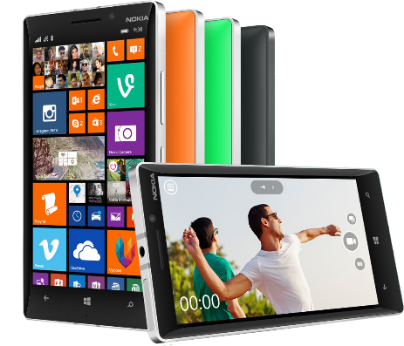


Office 365 development platform
Contextual apps
Robust Office 365 APIs
Flexible tools
Documents
Search
Mail
Social
Calendar
People
Notes:
Two kinds of apps :
you light up Office/Exchange/SharePoint.
You consume our services in a custom (device or web) app
Contextual apps
Rich, powerful interactive IW experiences
Do more, without leaving Excel, Outlook, PowerPoint, SharePoint
Consistent Framework everywhere that Office runs. Everywhere that people do work
Robust APIs
Big news
More for SharePoint Devs
Growing up outside SharePoint
Flexible Tools
Open-ness and choice is a core pillar
But … we just want to take away all the friction
Tools targeted to specific users
Platforms with best management, capability and scale
What does this mean. Where is the value
Breadth : more endpoints and experiences
Depth: richer APIs. More capabilities
Power:

Slide 8
Intro to the app model

Slide 9
Contextual apps
Surface your apps in the Office 365 platform
In context of your business users productivity activities
In Office Client, Office Online, and modern apps

Slide 10
Introducing the app model
SharePoint apps do not “live” on the SharePoint server
Custom code executes in the client, cloud or on-premises
Apps are granted permissions to SharePoint via OAuth
Apps communicate with SharePoint via REST/CSOM
Acquire apps via centralized location
App catalog
Public store (via submission process)
APIs for manual deployment
Notes:
To address many of the challenges developers and site owners had in previous versions of SharePoint, Microsoft has introduced a new development option for SharePoint 2013: The SharePoint App Model.
In this new model apps do not necessary live within SharePoint. Instead the app’s business logic executes within the context of the client (browser) or externally from SharePoint. This external option could be another non-SharePoint Web server or a cloud server. Apps are also more secure in that when they need to access SharePoint resources such as lists and libraries they must be explicitly granted permissions to do so. This is implemented using OAuth. When an app is created, the developer specifies which permission the app needs in order to function. When the app is installed, the user installing the app is prompted to accept the permission requests the app needs (if they deny the permissions, the app is not installed). Once granted permissions, the apps can then talk to SharePoint using the Client Side Object Model (CSOM) or using some of the new OData services in SharePoint.
Developers can build apps and submit them to a marketplace making it easy for customers to acquire these applications.

Slide 11






Modern app development
Apps
Products and platforms
Services and data
Expense
calculator
Vacation
request
Event
planning
Help-desk
support
Learning management
Risk
management
App catalog and store
Notes:
It’s worth spending some time taking you through how we think about modern app development at Microsoft. We have a series of products and platforms like SharePoint and Office that provide a lot of great out-of-the box functionality to help us be productive. To get even more from these products we want to be able to bring information in from other places. Services and data sources like Dynamics, Bing or something that lives out on the web or in the cloud.
With the latest version of SharePoint we’re making it easier to bring together rich web services and data to create powerful new apps. Apps run outside of the SharePoint process, are hosted externally and can be exposed through REST API’s.
Today there are more than 700,000 SharePoint application developers and with this release we’re providing them with a place to surface their apps through an online marketplace of rich partner solutions and applications designed to work with SharePoint and Office.

Slide 12
demo
Adding your first apps

Slide 13
Apps for SharePoint

Slide 14
SharePoint building blocks
Lists/libraries
Web parts
Site columns
Content types
Remote event receivers
Workflows

Slide 15
Architecture of apps
SharePoint
Azure
Web application
App 2
Web
App 2
SQL
App 2
Worker
Site collection
Root site
Apache
App 1
SP hosted
App 2
Provider hosted
App 3 Provider hosted
App 3
Web
App 3
mySQL
App 3
Worker
Sub site
IIS web server
App 3
Provider hosted
App 4
Provider hosted
App 4
Web
App 4
SQL
App 4 Windows service

Slide 16
Client-side pattern
SharePoint environment
Site collection
Lists
Site pages
CSS files
JavaScript files
Host web
App web
Notes:
The client-side pattern typically involves adding HTML pages, CSS files and JavaScript files to the app web. This makes it possible to add client-side code behind the pages of your app. You can also add quite a few other elements to the app web as well. Here is a short list of what you can add.
Site columns
Content types
List definitions
List instances
Site Pages
Web Part Pages
Web Parts
Custom Master Pages

Slide 17
Server-side pattern
SharePoint environment
Site collection
ASP.NET environment
On-premises or in Microsoft Azure
SQL server
On-premises data
Host web
Remote
web
Managed code
C# or VB
IFrame
SQL server
Cloud-based data
App web
Remote
web
Managed code
C# or VB
IFrame
Client-side object model calls
Notes:
The server-side pattern is great for experienced .NET developers because they are able to write strongly-typed code using C# and VB.NET. You also have the flexibility of picking your preferred execution environment (e.g. .NET 4.0, .NET 4.5, etc.) and not being constrained by all the frustrating limitations if running code inside the SharePoint environment.
In some scenarios, the external application associated with a SharePoint app will be self-contained which means it has not need to call into SharePoint to access content. In other scenarios, the external application associated with a SharePoint app will be required to call back into SharePoint to read and write content such as list items and/or documents within the host web or the app web.

Slide 18
Hybrid pattern
SharePoint environment
Site collection
ASP.NET environment
On-premises or in Windows Azure
SQL server
On-premises data
Host web
Remote
web service
Managed code
C# or VB
Custom JavaScript
SQL server
Cloud-based data
App web
Remote
web service
Managed code
C# or VB
Custom JavaScript
Client-side object model calls
Notes:
The hybrid pattern is the most flexible. You can mix and match as much client-side code and server-side code as you would like.

Slide 19
Provider versus SharePoint hosted
Provider hosted apps
Provider hosted apps
SharePoint hosted apps
Preferred hosting model for almost all types of apps
Good for smaller apps and resource storage
Full power of web—choose your infrastructure and technology
SharePoint-based; no server-side code
May require your own hosting
Automatically hosted in SharePoint
May require you own handling of multitenancy and permission management
Inherent multitenancy and isolation

Slide 20
Application isolation
When apps are provisioned, new SPWeb (AppWeb) created within hosting SPWeb
Each app resides within it’s own SPWeb for isolation
Special DNS address configured by administrators
App SPWeb’s live in separate domain (DNS)
Each app hosted on it’s own unique URL because
Blocks XSS: isolation to special SPWeb under special domain blocks cross site scripting
Enforces app permissions: apps communicate with sites via CSOM/API and must be granted to do so
Notes:
When an app is installed, SharePoint creates a special SharePoint site (SPWeb) for the app. This site, called an AppWeb, is given it’s own top-level URL that is different from the hosting site. This unique URL enforces two things:
Blocking cross site scripting (XSS) – because the hosting site & the AppWeb are in different domains, browsers will block any script that tries to access resources in different domains.
Enforcing App Permissions – apps will only be allowed to access SharePoint sites if they have been granted access to do so and when they do, they can access it using the CSOM or OData APIs.

Slide 21
Understanding the app URL
Scenario:
App installed in https://intranet.contoso.com
Dissecting the app URL:
https://tenant-APPUID.domain.com/APPNAME
https://app-bf473b5225nn0f.contoso.com/SharePointAppTitle
APPUID
APPNAME
Unique ID given to each app installation in tenancy
Makes each app domain unique
Name of SPWeb under where app is installed
Developers have control
Notes:
Consider an app installed in the SPWeb http://intranet.contoso.com
The app URL will be (for example): http://app-bf473b5225nn0f.apps.contoso.com/SharePointAppTitle
Dissecting the App URL (use http://fabrikam-APPUID.SharePoint.com/APPNAME in the following explanation):
APPUID: A unique 14 character identifier that is given to each app installation in that particular customer / tenancy. This makes the domain unique for each app.
APPNAME: The name of the SPWeb folder under which the app is installed. Currently this is a GUID and is automatically generated.
On-Premises Deployment:
In the case of an on-premise deployment, everything in the domain except APPUID is configurable by the administrator; administrators can specify tenant & domain.com in the above scenario. This is set once while preparing the farm to support apps.
Developers have control over the APPNAME within the AppManifest file of the app package.
Apps should be used with SSL when deployed to production.
Hosted / Office 365 Deployment:
In the case of a hosted deployment, the customer name (or tenant name) is determined when they create their account with Office 365 and it is not changed after that. The root domain (domain.com in the above scenario) is always SharePoint.com.

Slide 22
App entry points
App entry points
Start page
App parts
UI custom commands
The Chrome Control
Use the Chrome Control to inherit style and links from the host web in a cloud app
Notes:
20488A
08: Introducing Apps for SharePoint

Slide 23
The SharePoint client APIs
Lists and libraries
User profile
Search
Taxonomy
Feeds
…
_api
Execute query
REST/ OData
JavaScript library
Silverlight library
.Net CLR library
Custom client code

Slide 24
App scoping
Web scope
Can register and use resources in parent site, site collection
Tenant scope
Can register start page, custom actions
Tenant admins can filter-enable on sites
By site collection, managed path, template type
(SharePoint-hosted tenant-scope apps not available)
Notes:
Another consideration when building apps involves the scope of the app. Will the app be scoped to a SharePoint site (or a web) as a document library is, or will it be tenant scoped. Tenant scoped means that the app may contain data for multiple tenants (customers) and partition each experience per customer.
Tenant scoped apps can not reside in SharePoint… these types of apps can only be implemented as cloud apps.

Slide 25
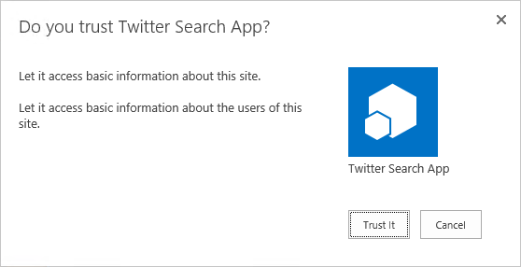
Apps in site collection hierarchy
1
3
app
2
2
https://*.contosoapps.com
4
https://intranet.contoso.com/sites/team
4
Root
https://intranet.contoso.com/sites/groupx
Sub site
AppWeb
Root
News
Organization
Teams
Search
AppWeb

Slide 26
Centrally deployed app
1
3
app
2
https://*.contosoapps.com
https://intranet.contoso.com/sites/catalog
Root
https://intranet.contoso.com/sites/team
AppWeb
AppWeb
Root
4
Sub site
https://intranet.contoso.com/sites/orgZ
4
Root
News
Organization
Teams
Search
AppWeb

Slide 27
Packaging and publishing apps
Packaging apps
.app file extension—a package typically includes the following files:
AppManifest.xml
AppIcon.png
Solution file
Data tier application package
Auto hosted apps
Publishing apps
Office Store
App catalogs
Notes:
20488A
08: Introducing Apps for SharePoint

Slide 28
Cross domain calls
Using the cross domain library
Access content in the app web from JavaScript in a remote web
SP.RequestExecutor.js
AppWebProxy.aspx
Using the web proxy
Access content in SharePoint or elsewhere from JavaScript in a remote web
SP.WebRequestInfo
Trusting domains for cross domain calls
Notes:
20488A
08: Introducing Apps for SharePoint

Slide 29

Authentication
SharePoint
Azure
Web application
App 2
Web
App 2
SQL
App 2
Worker
Site collection
Root site
Apache
App 1
SP hosted
App 2
provider hosted
App 3 provider hosted
App 3
Web
App 3
mySQL
App 3
Worker
Sub site
IIS web server
App 3
provider hosted
App 4
provider hosted
App 4
Web
App 4
SQL
App 4
Windows service

Slide 30
Versioning
SharePoint
Azure
Web application
App 2
SQL
V2.0.0.0
App 2
Worker
V2.0.0.0
App 2
SQL
V3.0.0.0
App 2
Worker
V1.0.0.0
App 2
Web
V3.0.0.0
App 2
Worker
V3.0.0.0
App 2
Web
V2.0.0.0
App 2
Web
V1.0.0.0
App 2
SQL
V1.0.0.0
Site collection
Root site
Apache
App 1
V1.0.0.0
App 1
V2.0.0.0
App 1
V3.0.0.0
App 3 V3.0.0.0
App 3 V2.0.0.0
App 2
V1.0.0.0
App 3 V1.0.0.0
App 2
V2.0.0.0
App 2
V3.0.0.0
App 3
Web
V2.0.0.0
App 3
SQL
V2.0.0.0
App 3
worker
V2.0.0.0
App 3
Web
V3.0.0.0
App 3
SQL
V3.0.0.0
App 3
worker
V3.0.0.0
App 3
Web
V1.0.0.0
App 3
SQL
V1.0.0.0
App 3
worker
V1.0.0.0
Sub site
IIS web server
App 4
V2.0.0.0
App 4
V1.0.0.0
App 3
V1.0.0.0
App 4
Web
V1.0.0.0
App 4
SQL
V1.0.0.0
App 4
Web
V2.0.0.0
App 4
SQL
V2.0.0.0

Slide 31
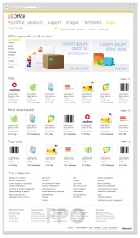
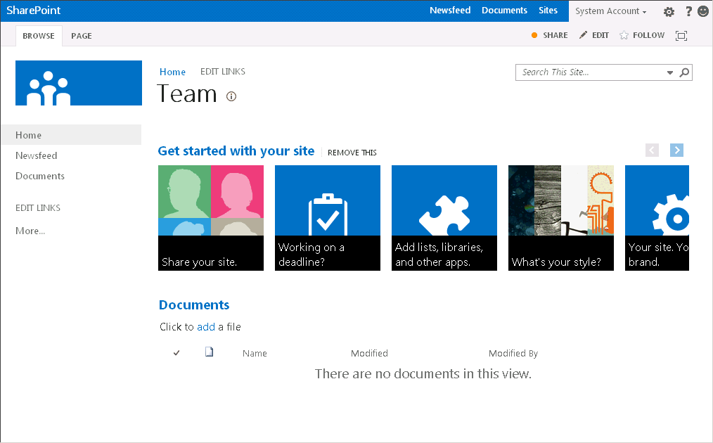
SP app upgrade process
Meetings app
V2.0.0.0
Marketplace
App 1.0.0.0
Meetings app
V1.0.0.0
App 1.0.1.0
Meetings app
V1.0.0.0
Meetings app
V2.0.0.0
Child Site A
Parent site
Child Site B
Child Site C
New version available

Slide 32
App scopes
SPSite—site collection
SPWeb—website
SPList—list
Tenancy—the tenancy scope is at http://<sharepointserver>/<content>/<tenant>/
performing search queries, accessing taxonomy data, user profiles, etc.
Notes:
An app uses permission requests to specify the permissions that it needs
The requests specify both the rights and scope which are needed
Scopes indicate where in the SharePoint hierarchy a permission request applies. SharePoint supports four different content scopes:
SPSite—site collection
SPWeb—website
SPList—list
Tenancy—the tenancy scope is at http://<sharepointserver>/<content>/<tenant>/
There are also scopes for things like performing search queries, accessing taxonomy data, user profiles, etc.

Slide 33
App rights
Rights
Read-only
Write
Manage
Full control (not supported in Store)
Not customizable if an app is granted permission to a scope
The permission applies to all children of the scope
Notes:
Permission rights indicate what an app is permitted to do within a scope. SharePoint supports four rights levels for content (there are others for things like search, term store, etc.):
Read-Only
Write
Manage
Full Control
Unlike SharePoint user roles, these rights levels are not customizable
If an app is granted permission to a scope, the permission applies to all children of the scope
If an app is granted perms to an SPWeb, the app is also granted perms to each SPList in the SPWeb, and all SPListItems in each list, but NOT each subweb

Slide 34
Setting app rights
App rights are set when
An app is installed by an SPWeb administrator
An app is explicitly granted permission by a tenant administrator or SPWeb administrator
An end-user gives consent
An app is removed
Once provisioned, the rights for an app cannot change—they can only be revoked in whole
This ensures the app will not have to account for missing rights, i.e., become broken after installation

Slide 35
App shapes for SharePoint
Full page
Implement complete app experiences to satisfy
business scenarios
Parts
Create app parts that can interact with the SharePoint experience
UI command extensions
Add new commands to the ribbon and item menus

Slide 36
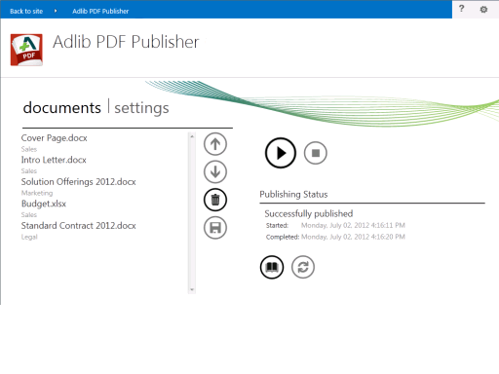
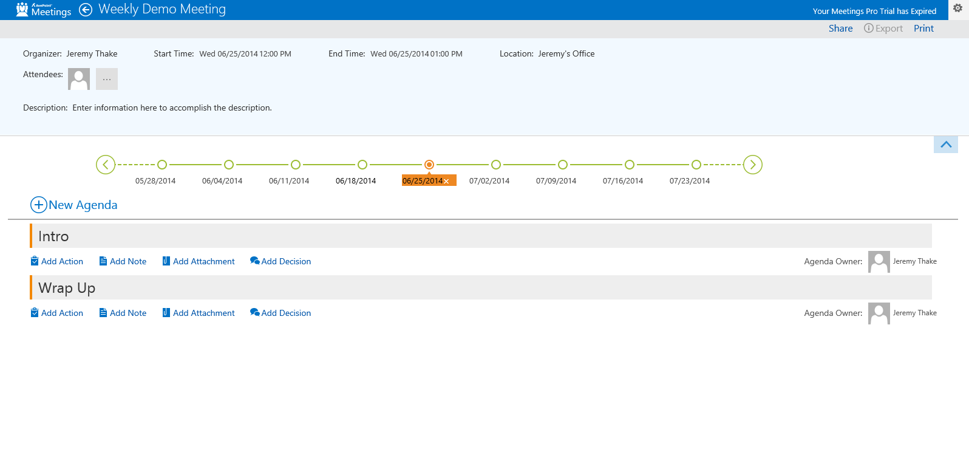

Slide 37
App shapes for SharePoint
Full page
Implement complete app experiences to satisfy business scenarios
Parts
Create app parts that can interact with the SharePoint experience
UI command extensions
Add new commands to the ribbon and item menus

Slide 38
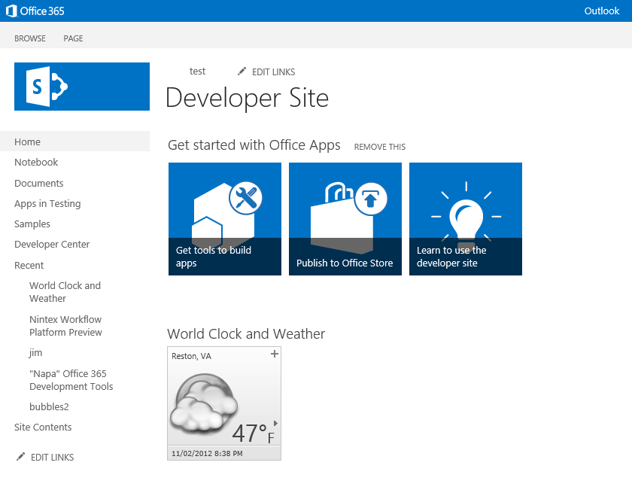
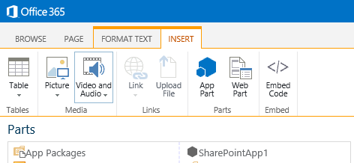

Slide 39
App shapes for SharePoint
Full page
Implement complete app experiences to satisfy business scenarios
Parts
Create app parts that can interact with the SharePoint experience
UI command extensions
Add new commands to the ribbon and item menus

Slide 40
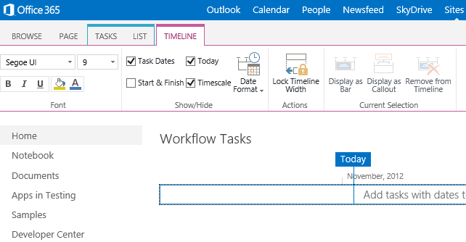

Slide 41
demo
Apps for SharePoint samples

Slide 42
Getting started

Slide 43
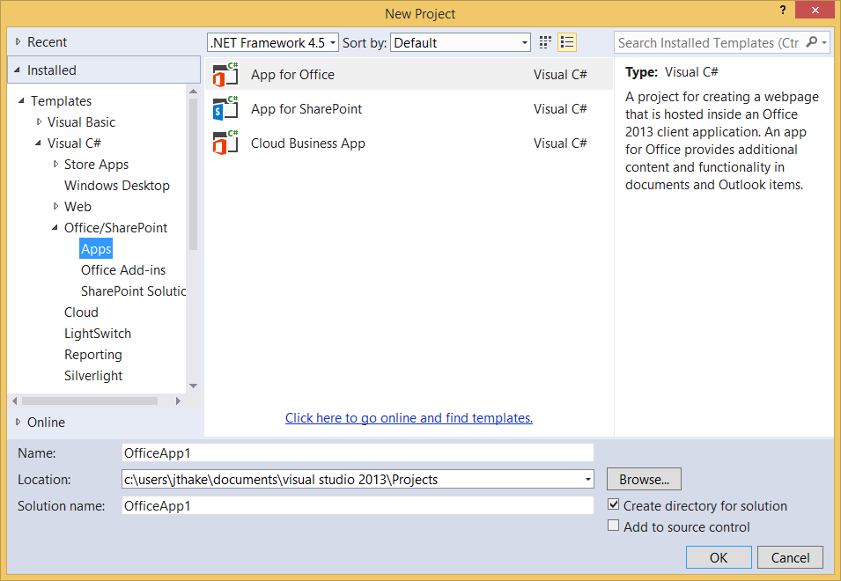
Visual Studio 2013

Slide 44
Environment
Office 365 developer tenant
Office 365 individual developer site collection
On-premises SharePoint server

Slide 45
demo
Building your first app for SharePoint

Slide 46
Conclusion
Surface your business solutions in Office 365 user interface
Leverage the building blocks of the platform
Use the development platform of your choice

Slide 47
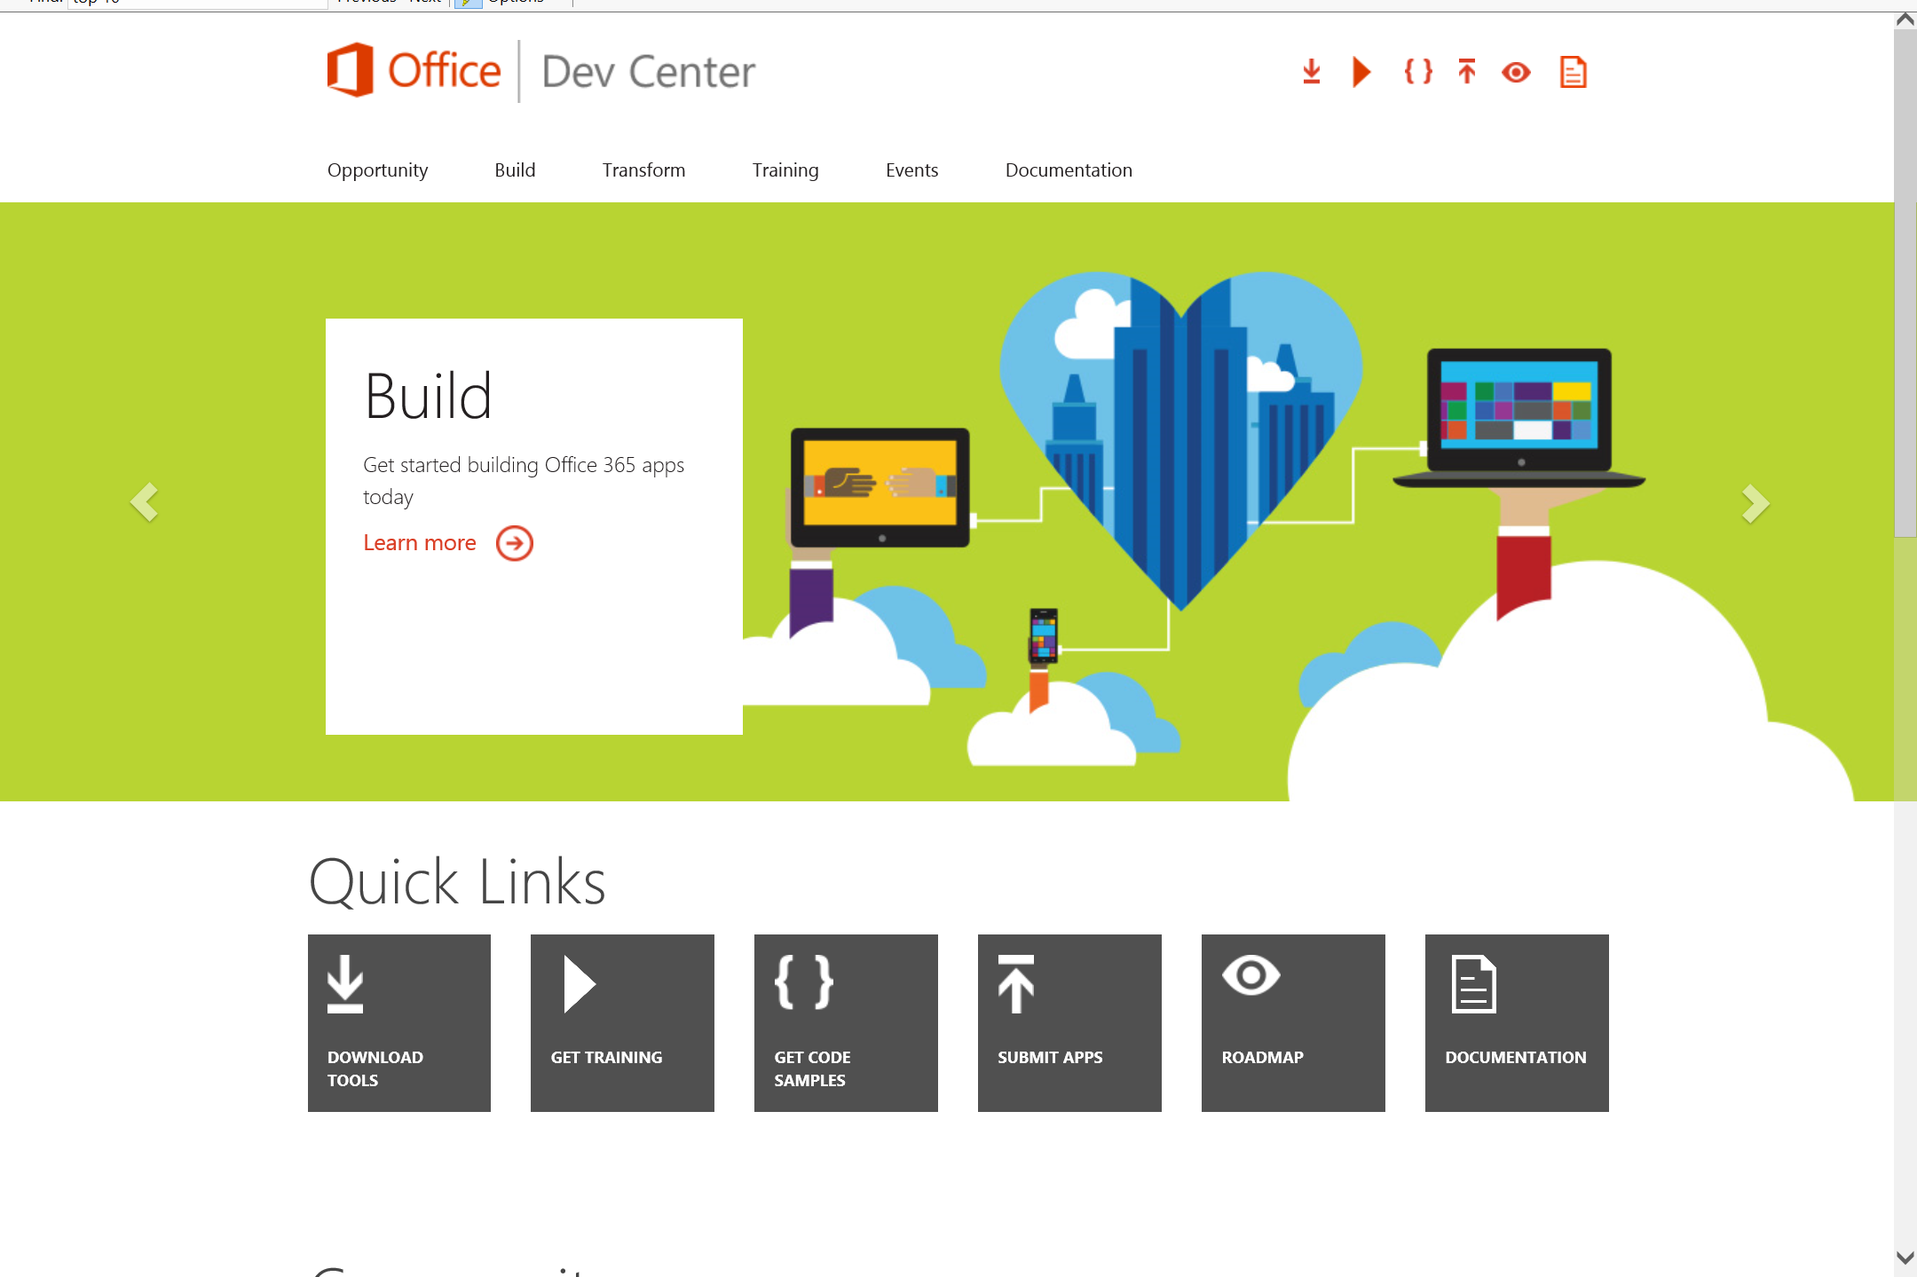
Dev.
Office
.com
One stop shop for Office Developer Platform

Slide 48

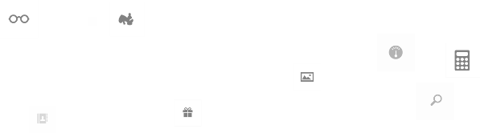
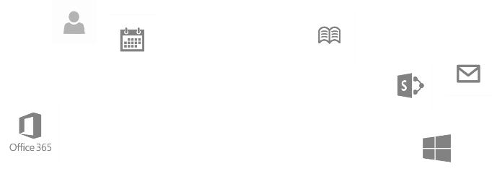
Calls to action
Explore our developer center
http://dev.office.com
Jumpstart into our training http://dev.office.com/training
Play with our code samples http://dev.office.com/code-samples
Get answers
http://aka.ms/AskSharePoint
http://aka.ms/AskOffice
Give feedback Drive our roadmap http://aka.ms/OfficeDevFeedback

Slide 49

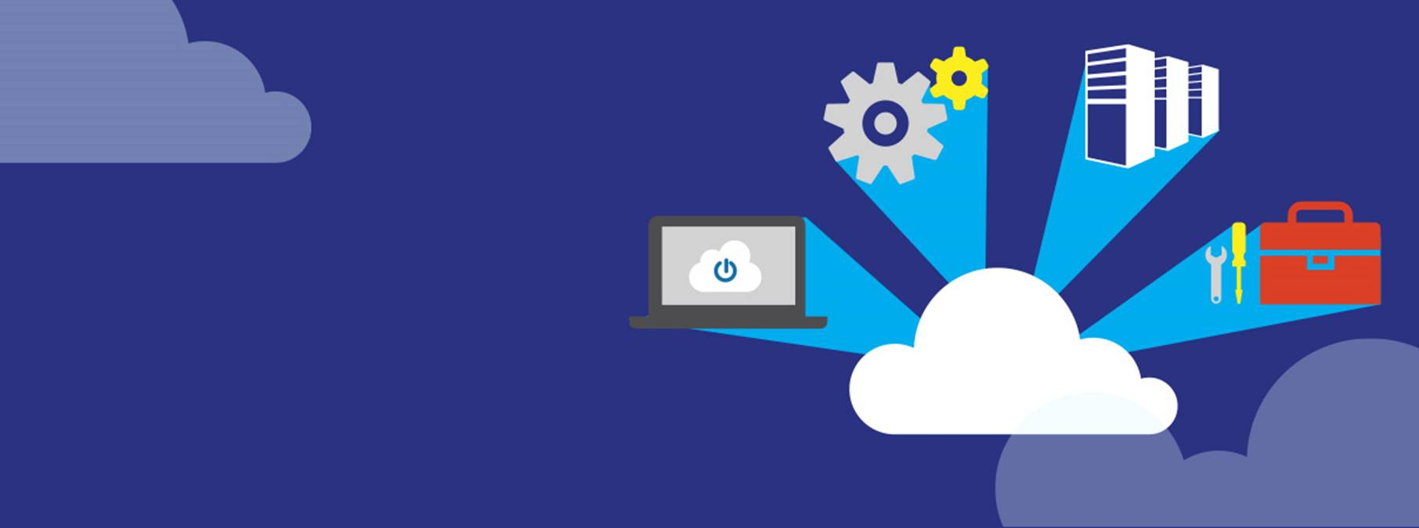
Transform your code Providing App Model Patterns for common Full Trust Code scenarios
60+ Visual Studio projects Common scenarios
Branding
Site provisioning
Remote event receivers
Large file support
Taxonomy driven navigation
And much more…
Contribute
Open source coming soon!
Developer
Patterns & Practices
aka.ms/OfficeDevPnP

Slide 50
Microsoft Virtual Academy courses
2014
2015
Deep Dive into integrating Office 365 APIs with your mobile device development
Deep dive into the building blocks and services of the SharePoint platform
Deep Dive into integrating Office 365 APIs with your standalone web application development
Introduction to Office 365 Development
Deep Dive into the Office 365 App Model
Deep Dive into Office 365 Development on non-Microsoft Stack
Shipping your Office 365 App to the Office Store
Aug
Sept
Oct
Nov
Dec
Jan
Feb

Slide 51

© 2014 Microsoft Corporation. All rights reserved. Microsoft, Windows, and other product names are or may be registered trademarks and/or trademarks in the U.S. and/or other countries.
The information herein is for informational purposes only and represents the current view of Microsoft Corporation as of the date of this presentation. Because Microsoft must respond to changing market conditions, it should not be interpreted to be a commitment on the part of Microsoft, and Microsoft cannot guarantee the accuracy of any information provided after the date of this presentation. MICROSOFT MAKES NO WARRANTIES, EXPRESS, IMPLIED OR STATUTORY, AS TO THE INFORMATION IN THIS PRESENTATION.

